Slide 1
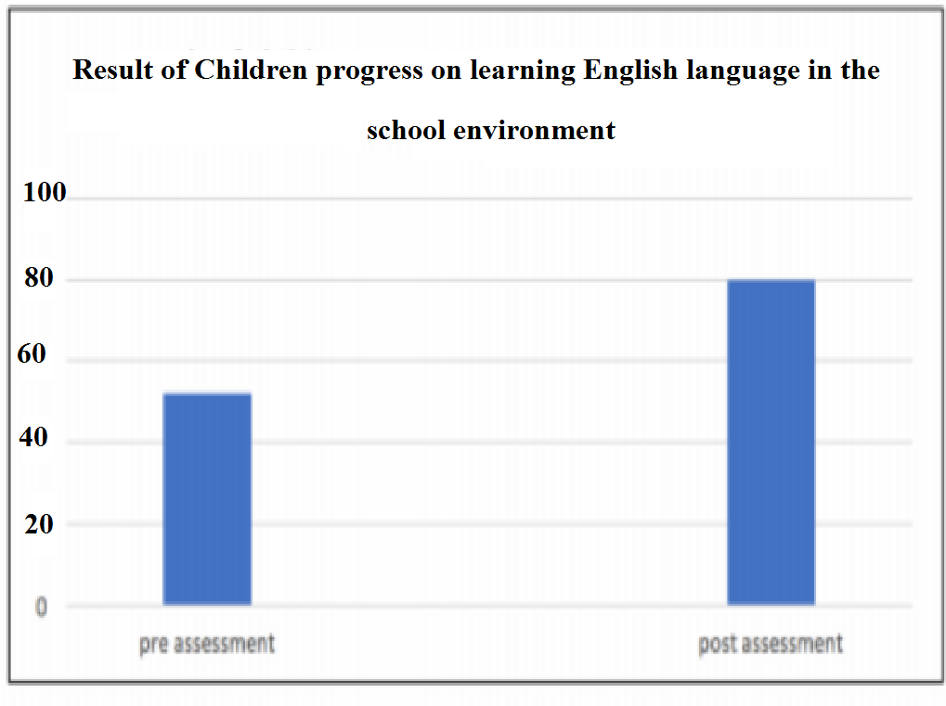





Instructional/ Management Intervention to Improve Student learning
Methodology
1) Learners:
Job, Grace, and George are young learners about 5 years old. The three learners are smart, active, and want to0 try or learn new things. The first language of the students is Arabic and they are in the First grade at Alshoroq public Kindergarten. The books the learners are choosing and the shows they are watching on TV improves their learning outside the school environment. Now the students can learn and are aware of some methods of learning for instance writing Arabic letters, and they like to pretend that they are reading at school. Job, Grace, and George school began with an English language program for learners this year since January. The teacher work with Job, Grace, and George every Monday and Friday for one hour, they do many things such as playing songs, doing activities, about English language.
2) Intervention procedures:
To improve Job, Grace, and George’s English learning, we focused on five motivational interventions strategies including; story-based instruction, positive teacher-student relationship, spending more hours learning, values-affirmation intervention , and redesigning mindset interventions. For the first activity, we used story-based instruction to help learners by motivating them. The second activity that w e have chosen is encouraging positive teacher-student relationship to drive the student learning. The third activity that we chose is spending more hours learning to help student improve their learning skills in the school environment. The fourth activity that we have chosen is values-affirmation intervention to help student believe in themselves that they are valuable. The final activity we used is redesigning mindset interventions.
3) Data collection techniques and instrument used for pre and post assessment:
Pre assessment:
The case objective is to measure the children’s English learning in the school environment. Therefore, we used an assessment sheet from (http://dibels.uoregon.edu/) and asked the three children to name the best motivational intervention while we go through the intervention. Based on the assessment result, the children could not recognize values-affirmation intervention and redesigning mindset interventions. When assessing with motivational strategies such as story-based instruction, positive teacher-student relationship and spending more hours learning, they were highly motivated, while when it comes to values-affirmation intervention , and redesigning mindset interventions, they were not highly motivated.
Post assessment:
The student post assessment showed that they were motivated to learn English in the school environment through ; story-based instruction, positive teacher-student relationship, and spending more hours learning and they were doing the assessment confidently.
4) Data recording and organization methods:
The study used a survey research design to investigate the instructional/management interventions to improve student learning. The children were trying to identify and tell their motivational strategies in improving English learning, we were taking notes on the motivational strategies that the three children could easily recognize. Also, asking questions assisted us in to know the interventions that the children are familiar with.
PICTURE FROM THE ACTIVITIES
Activity 1 story based instruction Activity 2 Teacher student relationship
Activity 3 spending more hours learning Activity 4 values-affirmation intervention
Activity 5 redesigning mindset intervention
Introduction
After assessing the learner, the main goal of this study is to do an intervention that will help in finding about what the student is struggling with. Improving students learning takes place at every stage in the achievement and learning process. However, student’s learning is driven by many factors from school environment or external rewards to student’s personal interests and goals. This paper is focused on effective strategies that have been selected to help student overcome the problem. This case will introduce strategies that have been used with the learner to help motivate student and improve their learning of English language. The main reason for choosing this topic is that is that; the instructional/management interventions are important in improving student learning. Also, motivating learners is essential because these motivational interventions are often used everywhere. Besides, this case study can assist teachers in choosing effective strategies to help group of learners struggling with learning by improving their learning.
When observing the child learning when while using story-based instruction, positive teacher-student relationship, and spending more hours learning, we could see an improvement in their learning. Seeing how the children reacted to each motivational activity we could see the children reacting to each activity making us to see the most effective activities or strategies and the ones which are not effective.
Findings
We worked for 2 weeks with the three children while applying the interventions. In each day, we worked with the children on each intervention to help overcome the problem of learning English in the school environment. Based on the post assessment, we can see an improvement on student’s learning when applying learning, story-based instruction, positive teacher-student relationship, and spending more hours learning strategies.
The study findings indicated that motivational interventions such as story-based instruction, positive teacher-student relationship, spending more hours learning, values-affirmation intervention , and redesigning mindset interventions helped in improving student learning.
Discussion & Recommendations
The five studies provided important information on how motivational information works and provided relevant basis for improving student learning. Additionally, all the scholars addressed the kinds motivational interventions such as story-based instruction, positive teacher-student relationship, spending more hours learning, values-affirmation intervention , and redesigning mindset which can helped in improving student learning. These interventions are essential for improving student learning for long-term success, especially across difficult schools where many learners get derailed. Thus, it is essential to incorporate story-based instruction, positive teacher-student relationship, and spending more hours learning to improve student learning. Additional future studies should also be conducted on story-based instruction, positive teacher-student relationship, spending more hours learning, values-affirmation intervention , and redesigning mindset interventions to help in improving student learning.
References
Brady, S. T., Reeves, S. L., Garcia, J., Purdie-Vaughns, V., Cook, J. E., Taborsky-Barba, S., ... & Cohen, G. L. (2016). The psychology of the affirmed learner: Spontaneous self-affirmation in the face of stress. Journal of Educational Psychology, 108(3), 353.
Duckworth, A. L., White, R. E., Matteucci, A. J., Shearer, A., & Gross, J. J. (2016). A stitch in time: Strategic self-control in high school and college students. Journal of educational psychology, 108(3), 329.
Gehlbach, H., Brinkworth, M. E., King, A. M., Hsu, L. M., McIntyre, J., & Rogers, T. (2016). Creating birds of similar feathers: Leveraging similarity to improve teacher–student relationships and academic achievement. Journal of Educational Psychology, 108(3), 342.
Lin-Siegler, X., Ahn, J. N., Chen, J., Fang, F. F. A., & Luna-Lucero, M. (2016). Even Einstein struggled: Effects of learning about great scientists’ struggles on high school students’ motivation to learn science. Journal of Educational Psychology, 108(3), 314.
Yeager, D. S., Romero, C., Paunesku, D., Hulleman, C. S., Schneider, B., Hinojosa, C., ... & Trott, J. (2016). Using design thinking to improve psychological interventions: The case of the growth mindset during the transition to high school. Journal of educational psychology, 108(3), 374.
Literature Review
In this case we focused on very essential area involving motivating group of learners to improve their learning. The area that we chose was the ability to motivate group of learners to improve their learning skills. According to the study conducted by Lin-Siegler et al. (2016), the researchers examined the impact of story-based instruction students’ academic performance and motivation in science classes. The study findings showed that student learning was improved by the participation in the struggle-story after the intervention. Besides, Duckworth et al. (2016) conducted a study on students’ theories on the most effective strategies in avoiding distracting activities during learning. The study results indicated that some of the strategies were seen by the students as most effective like improving learning by spending more hours learning. Additionally, Gehlbach et al. (2016) conducted a study on social motivation and the impact of teacher-student relationship on students 'learning and motivation. The findings showed that student learning can be improved by a positive teacher-student relationship. Brady et al. (2016) performed a research to examine how the positive impact of values-affirmation intervention persist over time. the results showed that students views on themselves as having integrity, agency, and efficacy are key drivers of improving student learning through motivation. Furthermore, Yeager et al. (2016) conducted a research study on redesigning mindset interventions and their effect school context. The study findings indicated that larger scale interventions enhanced achieve net and learning in students.

